Slide 1
Deep Learning
Jehn-Ruey Jiang
National Central University
Taoyuan City, Taiwan

Slide 2
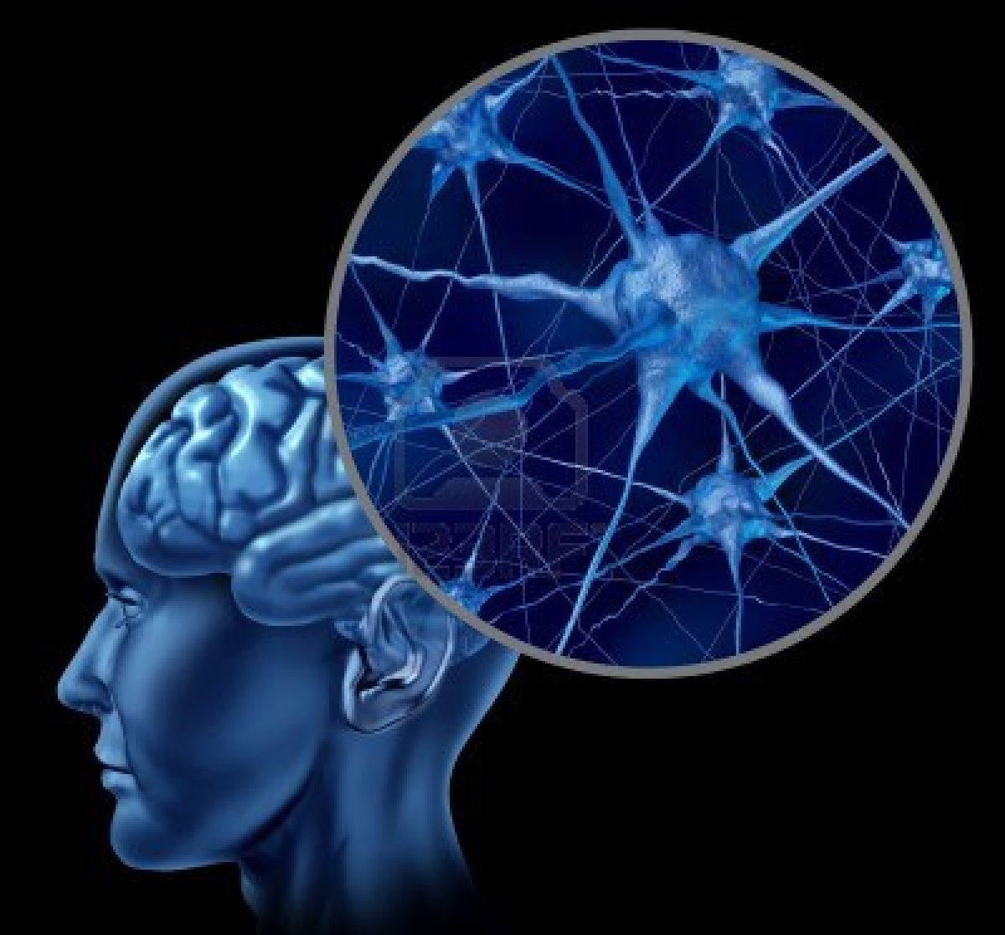
Neural Network in Brain
There are about 10 billion to 100 billion neurons in the human brain.
Each neuron is connected to other up to 100,000 neurons to form a complex neural network.
Notes:
There are about 10 billion to 100 billion (Wiki: 86 billion) neurons in the human brain, as shown in Figure 1. Neurons can receive signals (stimuli) from other neurons by dentites, and after the neuronal cell body collects (aggregates), the weak signal exceeds the threshold (threshold) , The signal will be along the long axon (axon) to the synapse (synapse), the processed signal to other neurons. Each neuron in the human brain is connected to other 10 to 100,000 neurons through synapses to form a complex neural network. Synaptic is a small gap between the end of a neuronal axon and the dendrites of another neuron. To stimulate the external environment, synapses can strengthen or weaken the links between neurons through electrochemical reactions to form the brain Memory and learning

Slide 3
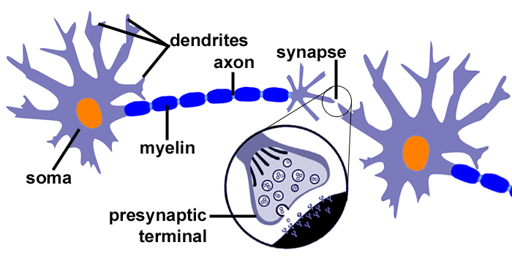
Neuron Structure
Source: http://www.topkeyword.info/105023-synapse-neuron-diagram.htm
Notes:
人類大腦中大約有100億至1000億(Wiki: 860億)個神經元，其結構如圖1所示。神經元可藉由樹突(dentrites)接收來自其他神經元的訊號(刺激)，經過神經元細胞本體(soma, or cell body)匯集(加總)處理之後，弱訊號加總強度超過某個門檻值(threshold)，則訊號會沿著長長的軸突(axon)送到突觸(synapse)，將處理過的訊號送到其他神經元。人類大腦中的每個神經元透過突觸與其他10到10萬個神經元互相連結，形成複雜的神經元網路。突觸是一個神經元軸突的末端跟另一個神經元的樹突之間的小空隙，為適應外界環境的刺激，突觸可以透過電化學反應強化或弱化神經元之間的連結，形成大腦記憶與學習的基礎。

Slide 4
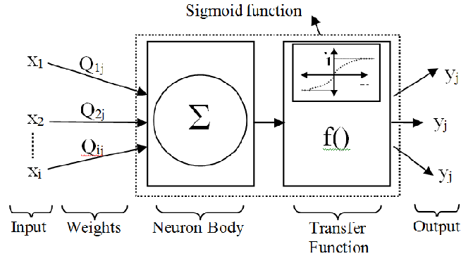
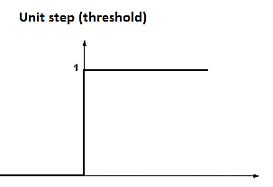
Artificial Neuron
Neuron: y_{j}= b+Σ_{i=1..n}x_{i}×w_{ij} = Σ_{i=0..n}x_{i}×w_{ij}
x₀=1
b
=w_{0j}
w_{1j}
w_{2j}
w_{nj}
x_{n}
Linear Transform
Nonlinear Transform
(Activation Function)
Adapted from: https://www.researchgate.net/publication/260432101_Modeling_of_Driver_Lane_Choice_Behavior_with_Artificial_Neural_Networks_ANN_and_Linear_Regression_LR_Analysis_on_Deformed_Roads

Slide 5
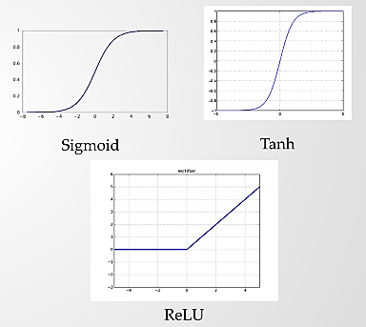
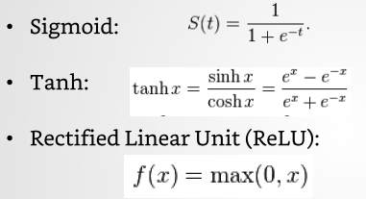
Nonlinear Activation Function
Source: https://www.slideshare.net/GauravMittal68/convolutional-neural-networks-cnn
Notes:
Tanh: Hyperbolic Tangent

Slide 6
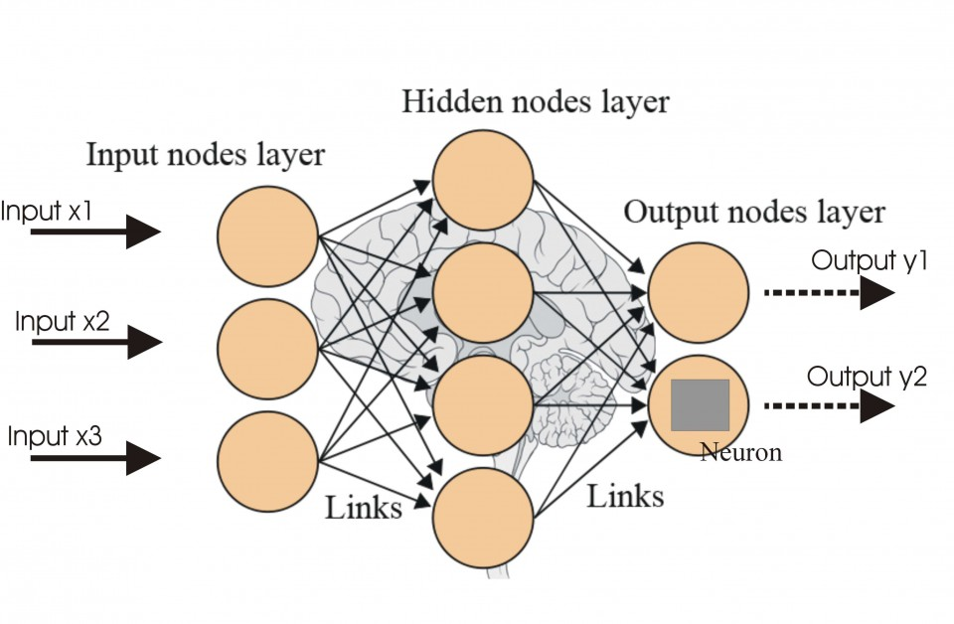
Artificial Neural Network (ANN)
Source: http://futurehumanevolution.com/artificial-intelligence-future-human-evolution/artificial-neural-networks

Slide 7
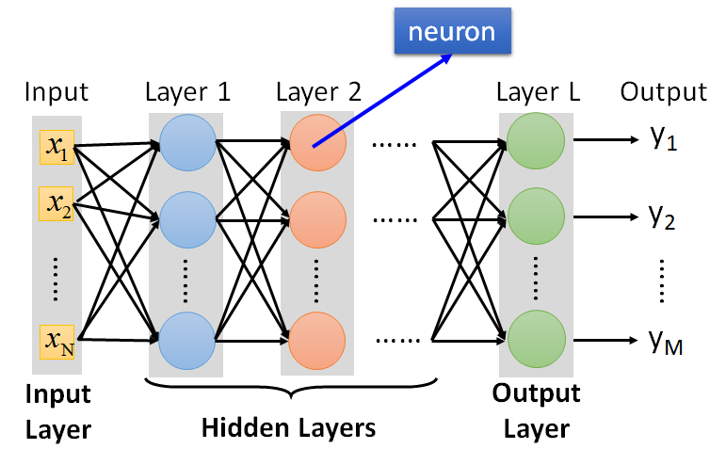
Deep Neural Network (DNN)
Source:http://speech.ee.ntu.edu.tw/~tlkagk/courses/ML_2017/Lecture/DL.pptx
Notes:
Machine Learning:
“Field of study that gives computers the ability to learn without being explicitly programmed.” – Arthur Samuel, IBM, Stanford University, 1959.
“A computer program is said to learn from experience E with respect to some task T and some performance measure P, if its performance on T, as measured by P, improves with experience E.” – Tom Mitchell [Mit97]
“Instead of writing a program by hand, we collect lots of examples that specify the correct output for a given input. A machine learning algorithm then takes these examples and produces a program that does the job.” -- Geoffrey Hinton [Hin 14]

Slide 8
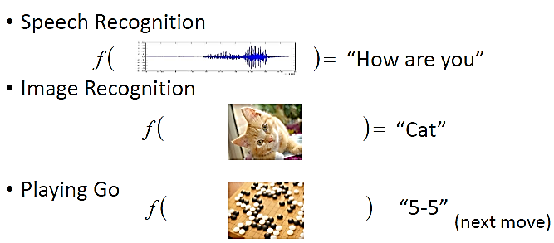
Deep Learning (DL: Machine Learning Using DNN)
Regression
ML_{DNN} (x₁, x₂, …., x_{n}) = (y₁, y₂, …., y_{m})
ML_{DNN}
ML_{DNN}
ML_{DNN}
Adapted from: https://www.slideshare.net/tw_dsconf/ss-62245351?from_action=save
Notes:
Learning methods in neural networks can be broadly classified in three basic types.
- Supervised Learning
- Unsupervised Learning
- Reinforcement Learning
Supervised Learning:-
In supervised learning, both the inputs and the outputs are provided. The network then processes the inputs and compares its resulting outputs against the desired outputs
Errors are then calculated, causing the system to adjust the weights which control the network.
Here a teacher is assume to be present during the learning process.
Unsupervised Learning:-
Here the target output is not presented to the network, Because there is no teacher to present the described patterns.
So the system learns of its own by discovering and adapting to structural features of the input patterns.
Reinforcement Learning:-
In this method, a teacher though available, does not present the expected answer but only indicates if the computed output is correct or incorrect.
The information provided helps the network in its learning process.
Here a reward is given for correct answer computed and a penalty for a wrong answer.

Slide 9
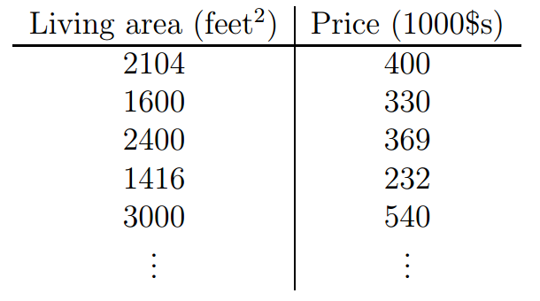
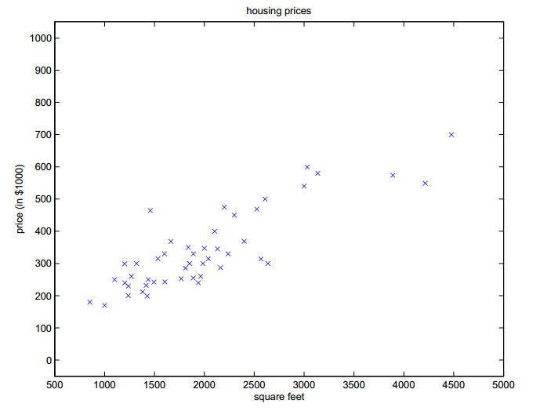
ML (Supervised Learning) Example: Linear Regression
We are given a dataset of the living areas and prices of 47 houses.
We are to predict (estimate) the price (y) of a house based on its living area (x).
y=h_{θ}(x)=θ₀+θ₁x=71.27+0.1345x
Source: Andrew Ng, CS229 Lecture Notes, http://cs229.stanford.edu/notes/cs229-notes1.pdf

Slide 10
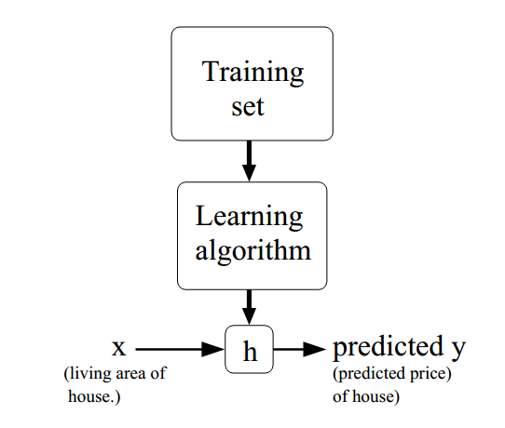
ML (Supervised Learning) Example: Linear Regression
One variable: Simple Linear Regression
Multiple variables:
Multiple Linear Regression (Multivariate Linear Regression)
Independent Variable
(Feature Variable)
Dependent Variable
(Target Variable)
Hypothesis
Source: Andrew Ng, CS229 Lecture Notes, http://cs229.stanford.edu/notes/cs229-notes1.pdf
Notes:
To establish notation for future use, we’ll use x^{(i)} to denote the “input”
variables (living area in this example), also called input features, and y^{(i)}
to denote the “output” or target variable that we are trying to predict
(price). A pair (x^{(i)} , y^{(i)} ) is called a training example, and the dataset
that we’ll be using to learn—a list of m training examples { (x^{(i)}, y^{(i)} ); i =
1, . . . , m } —is called a training set. Note that the superscript “(i)” in the
notation is simply an index into the training set, and has nothing to do with
exponentiation. We will also use X denote the space of input values, and Y
the space of output values. In this example, X = Y = R .
To describe the supervised learning problem slightly more formally, our
goal is, given a training set, to learn a function h : X → Y so that h(x) is a
“good” predictor for the corresponding value of y. For historical reasons, this
function h is called a hypothesis. Seen pictorially, the process is therefore
like this:
When the target variable that we’re trying to predict is continuous, such
as in our housing example, we call the learning problem a regression prob-
lem. When y can take on only a small number of discrete values (such as
if, given the living area, we wanted to predict if a dwelling is a house or an
apartment, say), we call it a classiﬁcation problem.

Slide 11
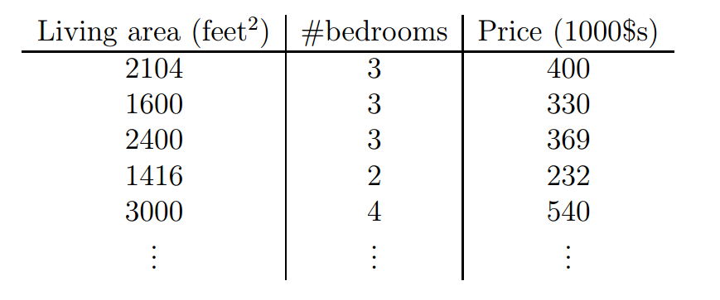
Multiple Linear Regression Example
We are given a dataset of two feature variables: living area (x₁) and the number of bedrooms (x₂).
We are to predict the house price(y) based on its living area and the number of bedrooms. y=h_{θ}(x)=θ₀+θ₁x₁+ θ₂x₂
Source: Andrew Ng, CS229 Lecture Notes, http://cs229.stanford.edu/notes/cs229-notes1.pdf
Notes:
To perform supervised learning, we must decide how we’re going to represent functions/hypotheses h in a computer. As an initial choice, let’s say we decide to approximate y as a linear function of x: hθ(x) = θ0 + θ1x1 + θ2x2 Here, the θi’s are the parameters (also called weights) parameterizing the space of linear functions mapping from X to Y. When there is no risk of confusion, we will drop the θ subscript in hθ(x), and write it more simply as h(x). To simplify our notation, we also introduce the convention of letting x0 = 1 (this is the intercept term), so that h(x) =n X i=0 θixi = θT x, where on the right-hand side above we are viewing θ and x both as vectors, and here n is the number of input variables (not counting x0).

Slide 12
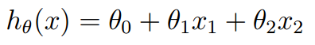
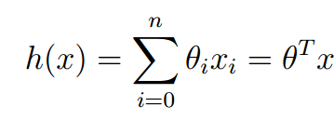
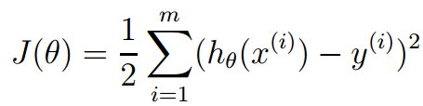
Cost Function for Multiple Linear Regression
We approximate y as a linear function of x (a vector of or a single-row matrix of [x₁, x₂]).
We drop the θ subscript in h_{θ}(x), and let x₀ = 1 for simplicity.
x is a vector of or a single-row matrix of [x₀, x₁, x₂].
θ is a vector of or a single-row matrix of [θ₀, θ₁, θ₂].
Cost Function (Loss Function or Error Function): How close the h(x^{(i)})’s are to the corresponding y^{(i)}’s, where i, 1≤ i ≤ m, is the number of data in the given data set.
Source: Andrew Ng, CS229 Lecture Notes, http://cs229.stanford.edu/notes/cs229-notes1.pdf

Slide 13
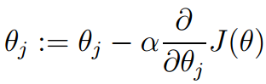
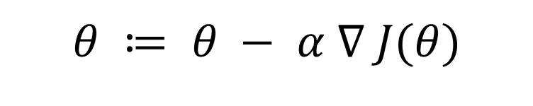
Gradient Descent
To minimize the cost function, the gradient descent algorithm starts with some initial θ, and repeatedly performs the update for every j, 0≤j≤n, where n is the number of parameters (without counting θ₀) and α is the learning rate.
We put the equation in the vector form, where ∇ stands for the gradient (grad) operator, pronounced as del or nabla.
$$θ ≔ θ − α ∇ J(θ)$$
∇J(θ) is the gradient of the function J(θ). It is the direction at which J(θ) increases the fastest.
Source: Andrew Ng, CS229 Lecture Notes, http://cs229.stanford.edu/notes/cs229-notes1.pdf
Notes:
StackOverflow Forum
Q:
Are epochs and training steps the same thing?
features = [tf.contrib.layers.real_valued_column("x", dimension=1)]
estimator = tf.contrib.learn.LinearRegressor(feature_columns=features)
y = np.array([0., -1., -2., -3.])
input_fn = tf.contrib.learn.io.numpy_input_fn({"x":x}, y, batch_size=4,
num_epochs=1000)
estimator.fit(input_fn=input_fn, steps=1000)
For example, do these "steps=1000" and "num_epochs=1000" mean exactly the same thing? If yes, why does it need to be duplicated? If not, can i set these two parameters differently?
A:
Here is the basic difference between epoch and steps in any machine learning algorithm or framework:
Once the framework goes through all the data points in its training set to update its parameters it's called one epoch. A step is one update of the parameters (e.g. weights of the neural network if it training DNN). This update can be obtained using a single data point, or a mini-batch of data points (e.g. randomly drawing 100 data points, with or without replacement), or all the points. Hence as you can see if all your datapoints are used in one step (or update of parameters) it becomes one epoch i.e. one step = one epoch.
Typically frameworks use mini-batching and in one step they batch 100 (or some other number) datapoints together and do one update. In this case, if say you have total 1 million datapoints (10^6) then one epoch has 10000 steps since one step contains 100 datapoints.
Q:
BTW, in my example, can I change the steps to "500" to "1000"? My understanding is not, since all the data points are used in one step due to batch size="4". If that's the case, why should I specify the "steps" parameter? Shouldn't it always be automatically calculated by "(# of data points/batch size) * epochs"? – user697911 May 8 at 23:47
add a comment
A:
No, they are not the same. As with most (all?) Frameworks, Tensorflow has some commands that specify epochs, and some that work on steps, a.k.a iterations. A step is one batch, which is governed by the batch size specified in the model's input.
For instance, if you are using AlexNet with its default batch size of 256, and the ILSVRC 2012 data set of roughly 1.28M images, then you have about 5000 steps per epoch (1,280,000 / 256).
Batch size is the number of images processed in parallel. If there are 1.28M images in the data set, then you have to process 12.8M images per epoch: that's the definition of epoch -- process each input once. Now is that arithmetic clear?

Slide 14
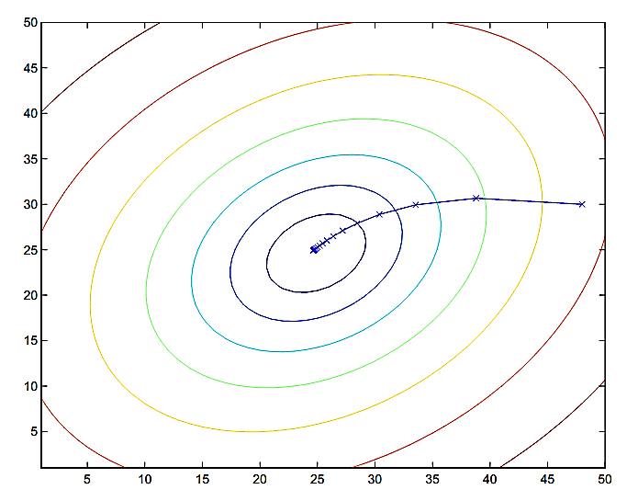
Cost Function Is Decreased by Gradient Descent
Source: Andrew Ng, CS229 Lecture Notes, http://cs229.stanford.edu/notes/cs229-notes1.pdf
Notes:
The ellipses shown above are the contours (等高線) of a quadratic function. Also shown is the trajectory taken by gradient descent, which was initialized at (48,30). The x’s in the figure (joined by straight lines) mark the successive values of θ that gradient descent went through.

Slide 15
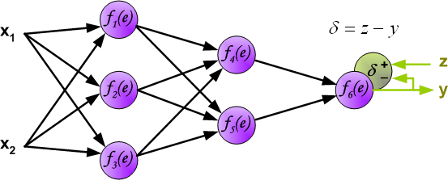
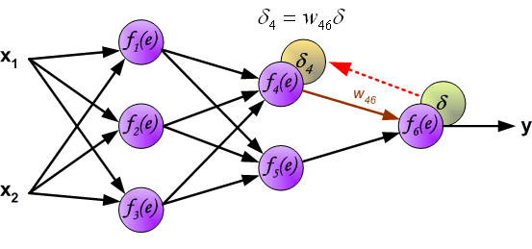
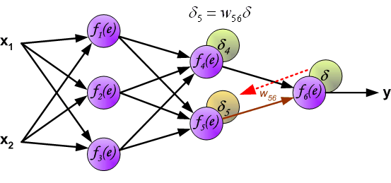
Error Backpropagation Learning Rule
Source: http://galaxy.agh.edu.pl/~vlsi/AI/backp_t_en/backprop.html

Slide 16
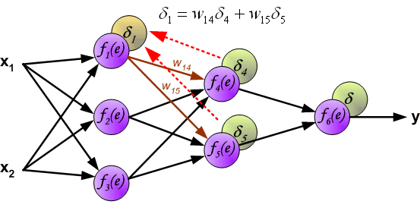
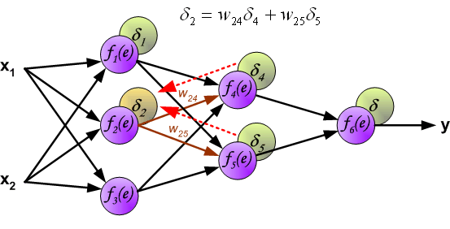
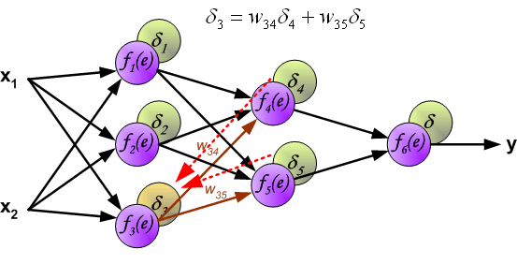
Error Backpropagation Learning Rule
Source: http://galaxy.agh.edu.pl/~vlsi/AI/backp_t_en/backprop.html

Slide 17
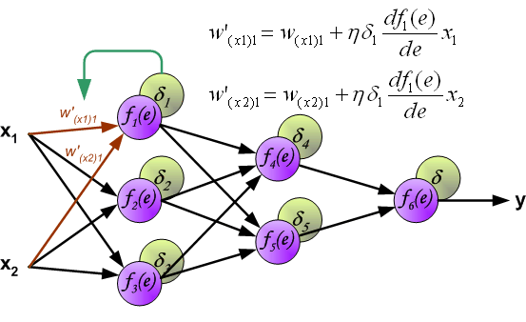
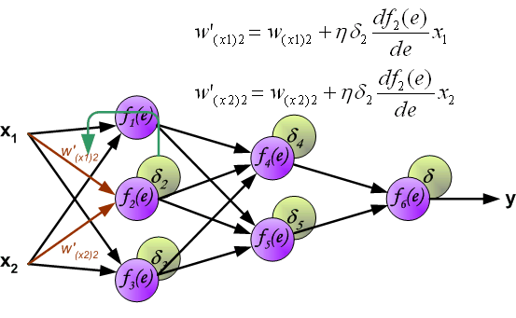
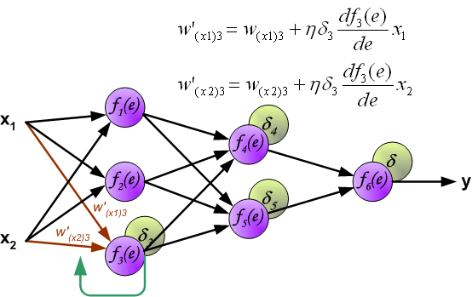
Error Backpropagation Learning Rule
Source: http://galaxy.agh.edu.pl/~vlsi/AI/backp_t_en/backprop.html

Slide 18
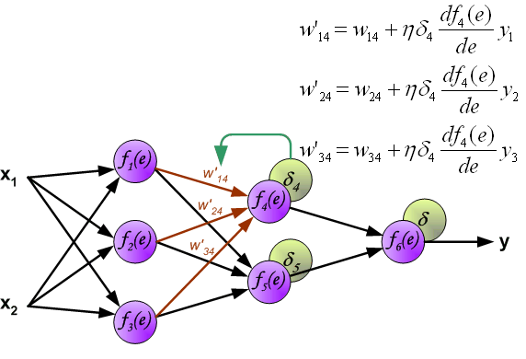
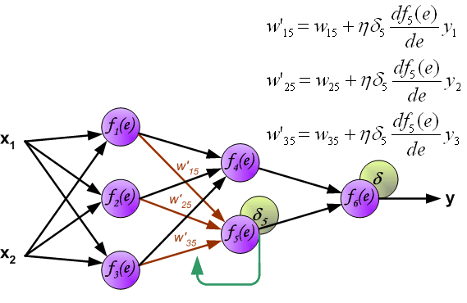
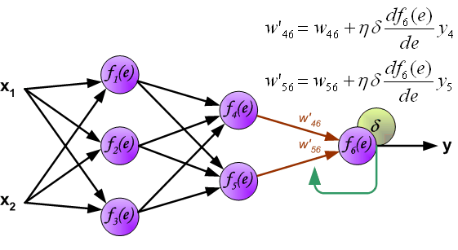
Error Backpropagation Learning Rule
Source: http://galaxy.agh.edu.pl/~vlsi/AI/backp_t_en/backprop.html

Slide 19
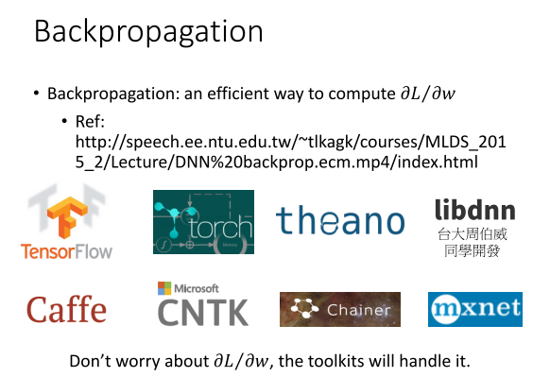
Source: https://www.slideshare.net/tw_dsconf/ss-62245351?from_action=save

Slide 20

Source: https://www.slideshare.net/tw_dsconf/ss-62245351?from_action=save

Slide 21
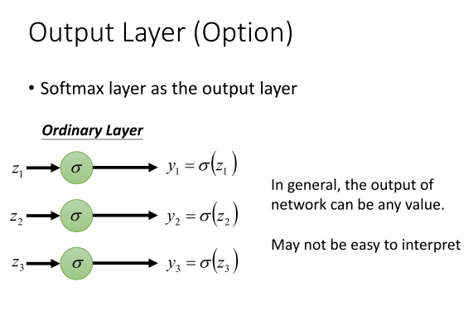
Source: https://www.slideshare.net/tw_dsconf/ss-62245351?from_action=save

Slide 22
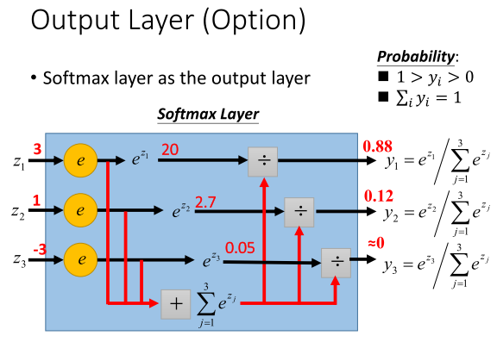
Source: https://www.slideshare.net/tw_dsconf/ss-62245351?from_action=save

Slide 23
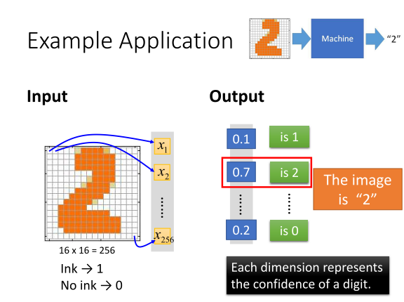
Source: https://www.slideshare.net/tw_dsconf/ss-62245351?from_action=save

Slide 24
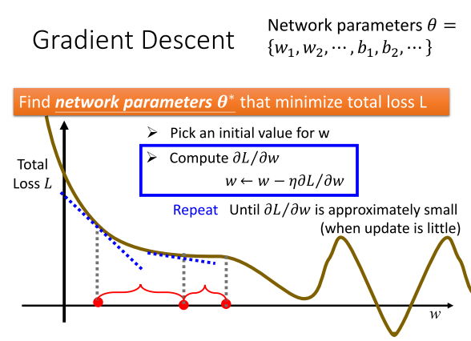
Source: https://www.slideshare.net/tw_dsconf/ss-62245351?from_action=save

Slide 25
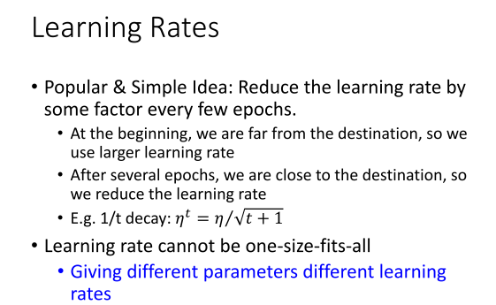
Source: https://www.slideshare.net/tw_dsconf/ss-62245351?from_action=save

Slide 26
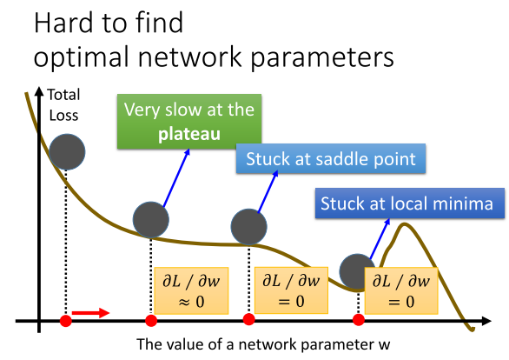
Source: https://www.slideshare.net/tw_dsconf/ss-62245351?from_action=save

Slide 27
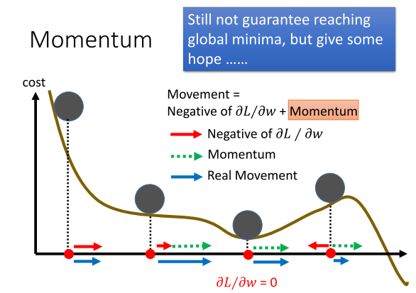
Source: https://www.slideshare.net/tw_dsconf/ss-62245351?from_action=save

Slide 28
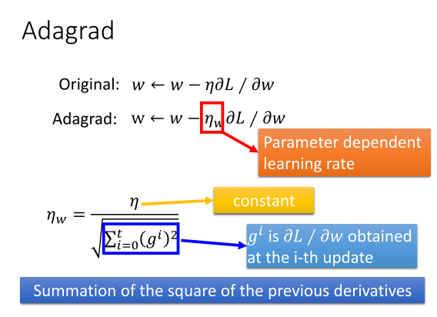
Source: https://www.slideshare.net/tw_dsconf/ss-62245351?from_action=save

Slide 29
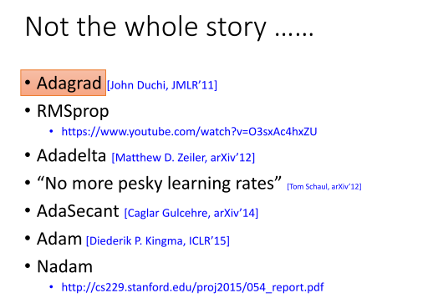
Source: https://www.slideshare.net/tw_dsconf/ss-62245351?from_action=save

Slide 30
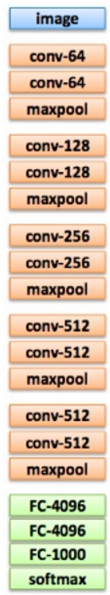
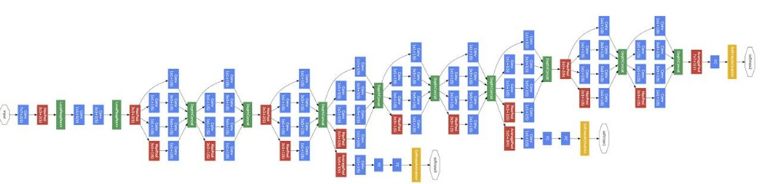
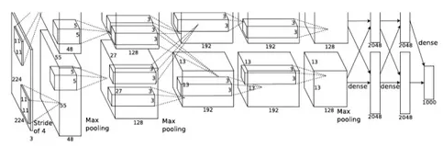
DNN Is Getting Deeper
22 layers
19 layers
8 layers
6.7%
7.3%
16.4%
AlexNet (2012)
VGG (2014)
GoogleNet (2014)
Source: http://speech.ee.ntu.edu.tw/~tlkagk/courses/ML_2017/Lecture/DL.pptx
Notes:
There are several architectures in the field of Convolutional Networks that have a name. The most common are:
LeNet. The first successful applications of Convolutional Networks were developed by Yann LeCun in 1990’s. Of these, the best known is the LeNet architecture that was used to read zip codes, digits, etc.
AlexNet. The first work that popularized Convolutional Networks in Computer Vision was the AlexNet, developed by Alex Krizhevsky, Ilya Sutskever and Geoff Hinton. The AlexNet was submitted to the ImageNet ILSVRC challenge in 2012 and significantly outperformed the second runner-up (top 5 error of 16% compared to runner-up with 26% error). The Network had a very similar architecture to LeNet, but was deeper, bigger, and featured Convolutional Layers stacked on top of each other (previously it was common to only have a single CONV layer always immediately followed by a POOL layer).
ZF Net. The ILSVRC 2013 winner was a Convolutional Network from Matthew Zeiler and Rob Fergus. It became known as the ZFNet (short for Zeiler & Fergus Net). It was an improvement on AlexNet by tweaking the architecture hyperparameters, in particular by expanding the size of the middle convolutional layers and making the stride and filter size on the first layer smaller.
GoogLeNet. The ILSVRC 2014 winner was a Convolutional Network from Szegedy et al. from Google. Its main contribution was the development of an Inception Module that dramatically reduced the number of parameters in the network (4M, compared to AlexNet with 60M). Additionally, this paper uses Average Pooling instead of Fully Connected layers at the top of the ConvNet, eliminating a large amount of parameters that do not seem to matter much. There are also several followup versions to the GoogLeNet, most recently Inception-v4.
VGGNet. The runner-up in ILSVRC 2014 was the network from Karen Simonyan and Andrew Zisserman that became known as the VGGNet. Its main contribution was in showing that the depth of the network is a critical component for good performance. Their final best network contains 16 CONV/FC layers and, appealingly, features an extremely homogeneous architecture that only performs 3x3 convolutions and 2x2 pooling from the beginning to the end. Their pretrained model is available for plug and play use in Caffe. A downside of the VGGNet is that it is more expensive to evaluate and uses a lot more memory and parameters (140M). Most of these parameters are in the first fully connected layer, and it was since found that these FC layers can be removed with no performance downgrade, significantly reducing the number of necessary parameters.
ResNet. Residual Network developed by Kaiming He et al. was the winner of ILSVRC 2015. It features special skip connections and a heavy use of batch normalization. The architecture is also missing fully connected layers at the end of the network. The reader is also referred to Kaiming’s presentation (video, slides), and some recent experiments that reproduce these networks in Torch. ResNets are currently by far state of the art Convolutional Neural Network models and are the default choice for using ConvNets in practice (as of May 10, 2016). In particular, also see more recent developments that tweak the original architecture from Kaiming He et al. Identity Mappings in Deep Residual Networks (published March 2016).
AlexNet is the name of a convolutional neural networkrunning on GPUs implemented in CUDA, which competed in the ImageNet Large Scale Visual Recognition Challenge^{[1]} in 2012. AlexNet was designed by Alex Krizhevsky.
Alexnet contained only 8 layers, first 5 were convolutional layers followed by fully connected layers.^{[2]}
The ImageNet project is a large visual database designed for use in visual object recognition software research. As of 2016, over ten million URLs of images have been hand-annotated by ImageNet to indicate what objects are pictured; in at least one million of the images, bounding boxes are also provided.[1] The database of annotations of third-party image URL's is freely available directly from ImageNet; however, the actual images are not owned by ImageNet.[2] Since 2010, the ImageNet project runs an annual software contest, the ImageNet Large Scale Visual Recognition Challenge (ILSVRC), where software programs compete to correctly classify and detect objects and scenes.

Slide 31

DNN Is Getting Deeper
152 layers
101 layers
22 layers
19 layers
3.57%
8 layers
7.3%
6.7%
16.4%
AlexNet (2012)
VGG
(2014)
GoogleNet
(2014)
Residual Net
(2015)
Taipei
101
Source: http://speech.ee.ntu.edu.tw/~tlkagk/courses/ML_2017/Lecture/DL.pptx
Notes:
169層

Slide 32
Why Deep? Fat + Short (Shallow) v.s. Thin + Tall (Deep)
The same number of parameters
Which one is better?
……
……
……
Shallow
Deep
Source: http://speech.ee.ntu.edu.tw/~tlkagk/courses/ML_2017/Lecture/Why.pptx

Slide 33
Fat + Short v.s. Thin + Tall
Layer X Size | Word Error Rate (%) | Layer X Size | Word Error Rate (%)
1 X 2k | 24.2
2 X 2k | 20.4
3 X 2k | 18.4
4 X 2k | 17.8
5 X 2k | 17.2 | 1 X 3772 | 22.5
7 X 2k | 17.1 | 1 X 4634 | 22.6
 |  | 1 X 16k | 22.1
Why?
Source: http://speech.ee.ntu.edu.tw/~tlkagk/courses/ML_2017/Lecture/Why.pptx and Seide, Frank, Gang Li, and Dong Yu. "Conversational Speech Transcription Using Context-Dependent Deep Neural Networks." Interspeech. 2011.

Slide 34
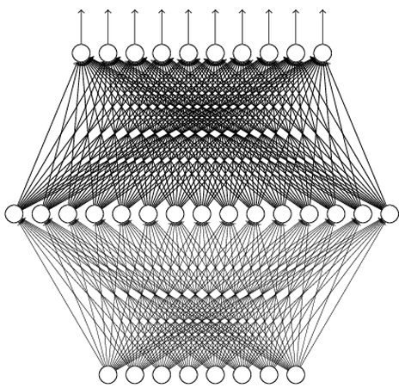
Universality Theorem
Any continuous function f
can be realized by a network with one hidden layer
(given enough hidden neurons)
Reference for the reason: http://neuralnetworksanddeeplearning.com/chap4.html
Yes, shallow network can represent any function.
However, using deep structure is more effective.
Source: http://speech.ee.ntu.edu.tw/~tlkagk/courses/ML_2017/Lecture/Why.pptx
Notes:
其實一層hidden layer已經是有兩層(hidden layer + output layer)神經元的運算了

Slide 35
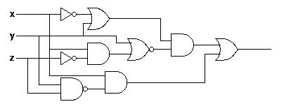
Analogy
Logic circuit
Logic circuit consists of gates
Two layers of logic gates can represent any Boolean function.
Using multiple layers of logic gates to build some functions is much simpler
Neural network consists of neurons
A hidden-layer network can represent any continuous function.
Using multiple layers of neurons to represent some functions is much simpler
Neural network
less parameters
less gates needed
less data?
Source: http://speech.ee.ntu.edu.tw/~tlkagk/courses/ML_2017/Lecture/Why.pptx
Notes:
Recall Circuit Design:
 理論上只要兩層gates即可表示所有涵數
 但實際上非常少電路設計, 只用兩層!!
 Why?
→ 反而更複雜
Exponentially grow!!
 SAT is NP-complete
Solution:
 Use more layers (or blocks)
to squeeze the size.

Slide 36
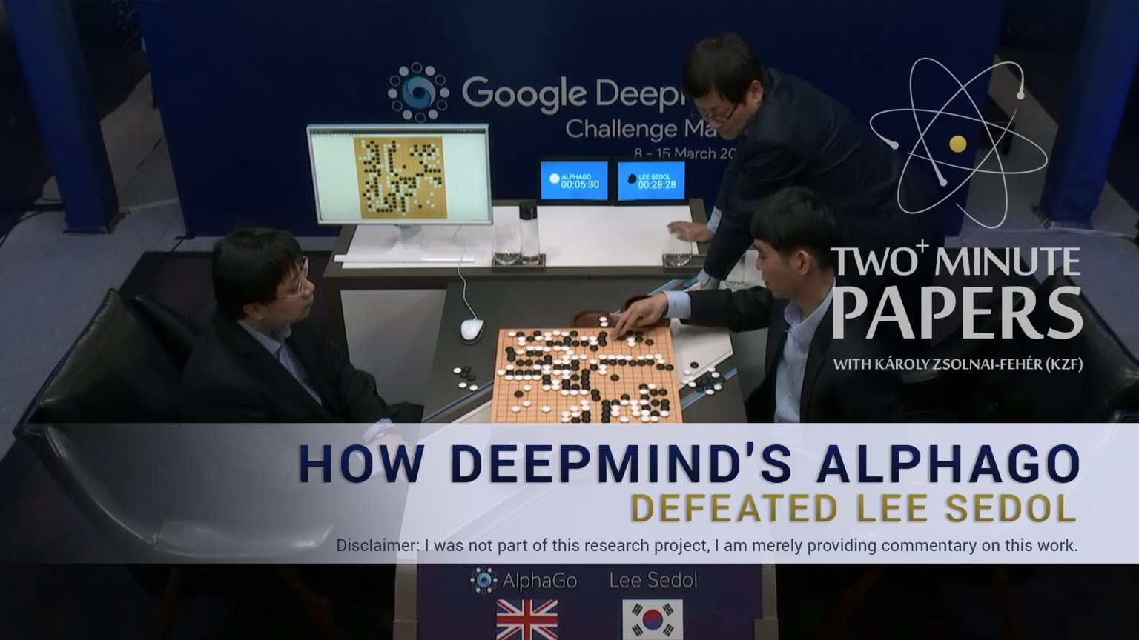
Source: https://www.youtube.com/watch?v=a-ovvd_ZrmA
Notes:
李世乭（韓語：이세돌，1983年3月2日－），韓國圍棋九段棋士，成長於韓國全羅南道新安郡飛禽島，所以又被稱為「飛禽島少年」。又因其出道初期於韓國國內戰績顯赫，也被稱為「不敗少年」。
「乭」非中文漢字，而是朝鮮漢字，本義「石」，發音「dol」
採取5局賽制，最後比數4:1，第四局Alphago亂下…..
升級版Alpha Go化名Master挑戰圍棋高手，創下60連勝
圍棋界最近因網上一位名為「Master」的棋手而風雲變色。這位神秘高手連日來在大陸著名圍棋對弈平台奕城網和騰訊的野狐圍棋與來自中日韓的九段高手以及一眾名將對弈，一口氣連勝60局。Master的手下敗將分別包括日本圍棋第一人井山裕太、號稱「中國圍棋第一人」的柯潔、中國「棋聖」聶衛平以及韓國高手朴廷桓。連日來的勝利都讓外界紛紛猜測這神秘棋手的身份。
在2017年1月4日晚間戰勝了中國籍世界冠軍古力之後，這位神秘棋手就揭曉了身份：在去年(2016)3月擊敗韓國棋手李世石，引起一陣轟動的圍棋AI Alpha Go。Master於對戰聊天室宣佈「我是 AlphaGo 的黃博士」，正式表明身份。Master所指的黃博士為來自台灣的黃士傑博士，是Alpha Go的核心開發成員，亦是一位業餘棋手。在去年與南韓棋手李世石的博弈以及這次和云云高手的挑戰中，黃士傑就代為落子。

Slide 37
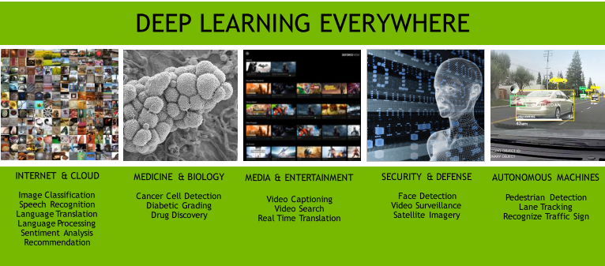
Source: https://www.slideshare.net/kuanhoong/an-introduction-to-deep-learning-64170092

Slide 38
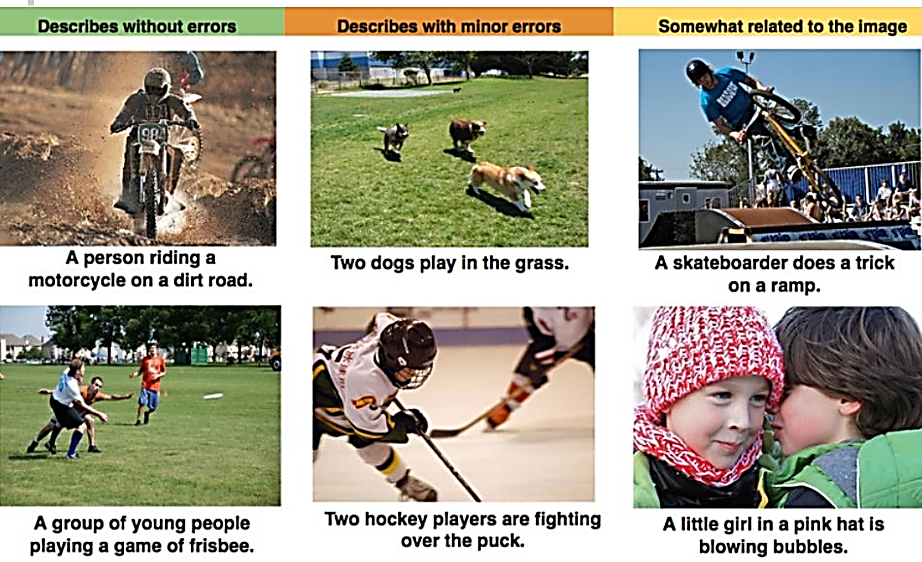
Image Captioning
Source: https://www.slideshare.net/tw_dsconf/ss-70083878?from_action=save

Slide 39
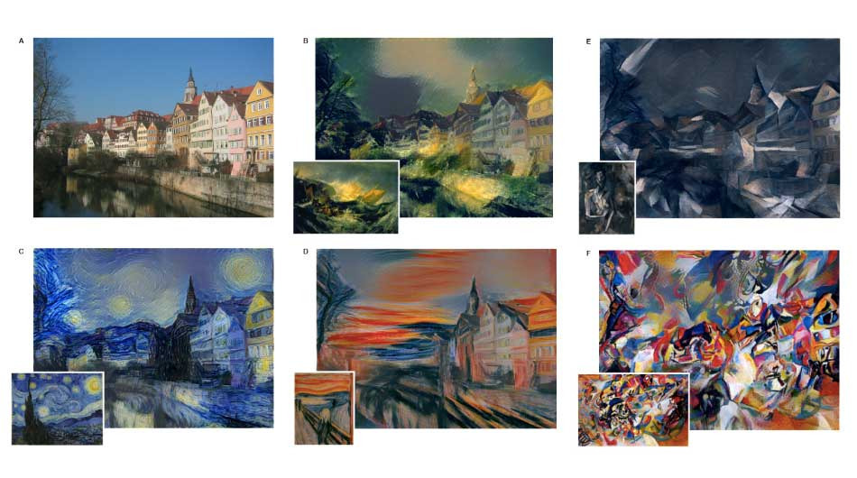
Arts
Source: http://arxiv.org/abs/1508.06576
Notes:
A (Photo:
Andreas Praefcke). The painting that provided the style for the respective generated image
is shown in the bottom left corner of each panel. B The Shipwreck of the Minotaur by J.M.W.
Turner, 1805. C The Starry Night by Vincent van Gogh, 1889. D Der Schrei by Edvard Munch,
1893. E Femme nue assise by Pablo Picasso, 1910. F Composition VII by Wassily Kandinsky, 1913.

Slide 40

Poems
Source: http://emnlp2014.org/papers/pdf/EMNLP2014074.pdf

Slide 41


Video Games
Source: http://arxiv.org/pdf/1312.5602v1.pdf

Slide 42
Q&A

